Slide 1
Design and Analysis of Algorithms Activity selection, 0-1 knapsack, and fractional knapsack
Haidong Xue
Summer 2012, at GSU

Slide 2
Activity selection
Activity = <start time s, finish time f>, f>=s
A set of activities:
a1
a2
a3
0
1
2
3
4
5
6
7
8
9
10
11
12
13
14
15
16

Slide 3
Activity selection
Compatible activity set:
A set of activities
Activities do not overlap

Slide 4
Activity selection
a3
a1
a2
0
1
2
3
4
5
6
7
8
9
10
11
12
13
14
15
16
Compatible: No

Slide 5
Activity selection
a3
a1
a2
0
1
2
3
4
5
6
7
8
9
10
11
12
13
14
15
16
Compatible: Yes

Slide 6
Activity selection
a3
a1
a2
0
1
2
3
4
5
6
7
8
9
10
11
12
13
14
15
16
Compatible: Yes

Slide 7
Activity selection
Maximum-size compatible activity set:
A compatible activity set
Has the largest set size among all compatible activity sets

Slide 8
Activity selection
a3
a1
a2
0
1
2
3
4
5
6
7
8
9
10
11
12
13
14
15
16
What is a maximum-size compatible activity set?
{a1, a2}

Slide 9
Activity selection
a3
a1
a2
0
1
2
3
4
5
6
7
8
9
10
11
12
13
14
15
16
What is a maximum-size compatible activity set?
{a1, a2, a3}

Slide 10
Activity selection
a3
a1
a2
0
1
2
3
4
5
6
7
8
9
10
11
12
13
14
15
16
What is a maximum-size compatible activity set?
{a1, a2} or {a2, a3}

Slide 11
Activity selection
Activity selection problem: given a activity set A, |A|=n, find out what is a compatible maximum-activity set
Can you design an algorithm to solve this problem?
Brute force
Divide and conquer
Dynamic programming
Greedy

Slide 12

Activity selection
Brute force
AS_BruteForce( A )
for each subset S in A{
max = -infinity;
re = $∅$;
if(S is compatible && |S|>max){
Max = |S|;
re = S;
}
}
return re;
Time complexity?
$Θ$($2^{|S|}$)

Slide 13
Activity selection
Divide-and-conquer
Base case?
Recursive case?
a4
a3
a2
a1
0
1
2
3
4
5
6
7
8
9
10
11
12
13
14
15
16

Slide 14

Activity selection
Divide-and-conquer-base case?
if A is $∅$
The maximum-size compatible activity set is $∅$
0
1
2
3
4
5
6
7
8
9
10
11
12
13
14
15
16

Slide 15
Activity selection
Divide-and-conquer – recursive
Divide it by choosing one activity in the maximum-size compatible activity set
a4
a3
a2
a1
0
1
2
3
4
5
6
7
8
9
10
11
12
13
14
15
16

Slide 16
Activity selection
When a1 is chosen, the problem can be solved by:
AS(compatible activities on the left of a1) + AS(compatible activities on the right of a1) + {a1}
empty
a4
a3
a2
a1
0
1
2
3
4
5
6
7
8
9
10
11
12
13
14
15
16

Slide 17
Activity selection
When a2 is chosen, the problem can be solved by:
AS(compatible activities on the left of a2) + AS(compatible activities on the right of a2) + {a2}
a4
a3
a2
a1
0
1
2
3
4
5
6
7
8
9
10
11
12
13
14
15
16

Slide 18
Activity selection
When a3 is chosen, the problem can be solved by:
AS(compatible activities on the left of a3) + AS(compatible activities on the right of a3) + {a3}
You may have already seen some overlapped subproblems
empty
a4
a3
a2
a1
0
1
2
3
4
5
6
7
8
9
10
11
12
13
14
15
16

Slide 19
Activity selection
When a4 is chosen, the problem can be solved by:
AS(compatible activities on the left of a4) + AS(compatible activities on the right of a4) + {a4}
a4
empty
a3
a2
a1
0
1
2
3
4
5
6
7
8
9
10
11
12
13
14
15
16

Slide 20
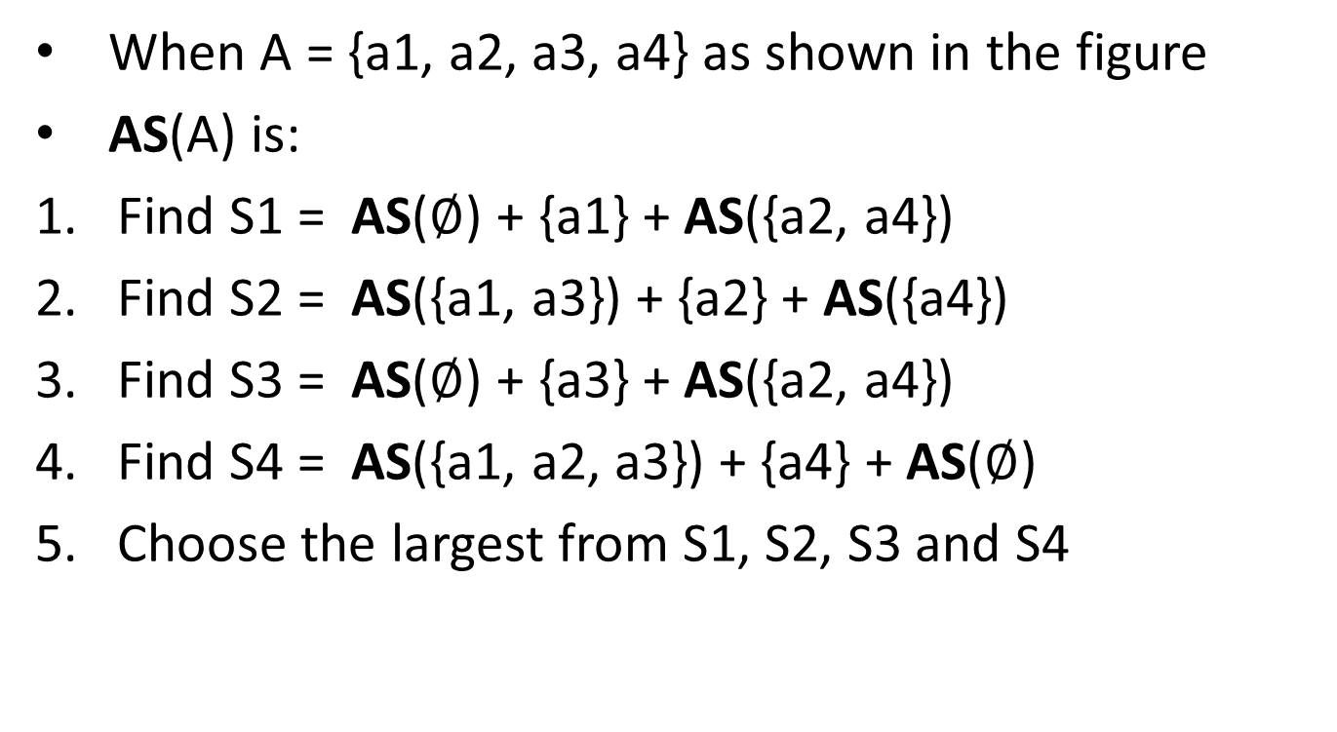
Activity selection
When A = {a1, a2, a3, a4} as shown in the figure
AS(A) is:
Find S1 = AS($∅$) + {a1} + AS({a2, a4})
Find S2 = AS({a1, a3}) + {a2} + AS({a4})
Find S3 = AS($∅$) + {a3} + AS({a2, a4})
Find S4 = AS({a1, a2, a3}) + {a4} + AS($∅$)
Choose the largest from S1, S2, S3 and S4
Many subproblems are overlapped!
a4
a3
a2
a1
0
1
2
3
4
5
6
7
8
9
10
11
12
13
14
15
16

Slide 21
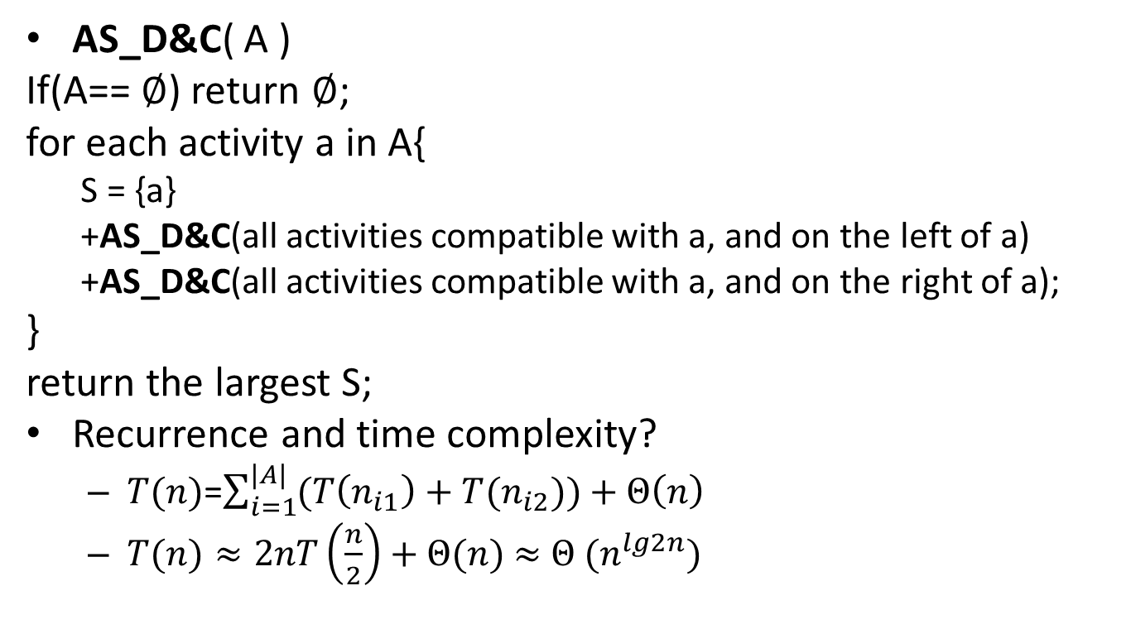
Activity selection
AS_D&C( A )
If(A== $∅$) return $∅$;
for each activity a in A{
S = {a}
+AS_D&C(all activities compatible with a, and on the left of a)
+AS_D&C(all activities compatible with a, and on the right of a);
}
return the largest S;
Recurrence and time complexity?
$T(n)$=$\sum_{i=1}^{|A|}{(T\left(n_{i1}\right)+T(n_{i2}))}+Θ\left(n\right)$
$T(n)≈2nT\left(\frac{n}{2}\right)+Θ(n)$ $≈$ $Θ (n^{lg2n})$

Slide 22
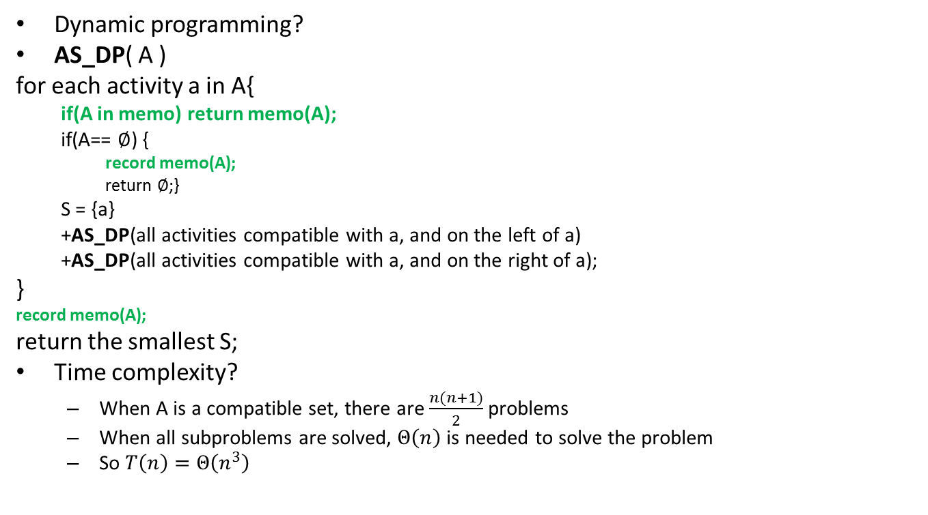
Activity selection
Dynamic programming?
AS_DP( A )
for each activity a in A{
if(A in memo) return memo(A);
if(A== $∅$) {
record memo(A);
return $∅$;}
S = {a}
+AS_DP(all activities compatible with a, and on the left of a)
+AS_DP(all activities compatible with a, and on the right of a);
}
record memo(A);
return the smallest S;
Time complexity?
When A is a compatible set, there are $\frac{n(n+1)}{2}$ problems
When all subproblems are solved, $Θ\left(n\right)$ is needed to solve the problem
So $T\left(n\right)=Θ\left(n^{3}\right)$

Slide 23
Activity selection
Can we do it using greedy algorithm?
What is the correct greedy choice?
Do we have optimal substructure?
Greedy choice
Always choose the activity with the smallest finish time
Optimal substructure
{smallest finish time a} + AS(the activity on the right of a and compatible with a)

Slide 24
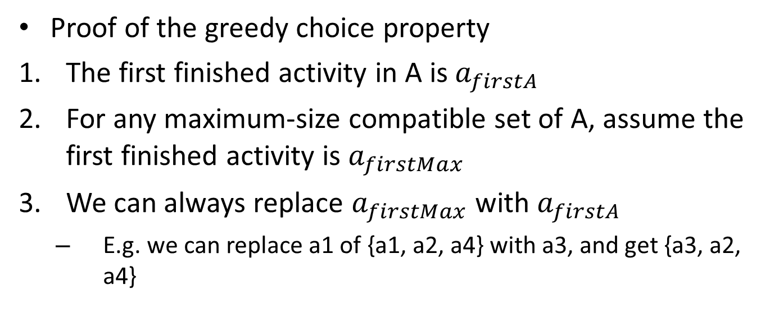
Activity selection
Proof of the greedy choice property
The first finished activity in A is $a_{firstA}$
For any maximum-size compatible set of A, assume the first finished activity is $a_{firstMax}$
We can always replace $a_{firstMax}$ with $a_{firstA}$
E.g. we can replace a1 of {a1, a2, a4} with a3, and get {a3, a2, a4}
a4
a3
a2
a1
0
1
2
3
4
5
6
7
8
9
10
11
12
13
14
15
16

Slide 25
Activity selection
Proof of optimal substructure in an example
Assuming that without sub optimal solution we still can construct the current optimal solution
The sub optimal solution of AS({a2, a4}) is indicated by S1
i.e. there is another solution of AS({a2, a4}) S2, |S2|<|S1|, and S2+{a3} is the optimal solution
Because |S2|<|S1|, |S2+{a3}|<|S1+{a3}|, and it contradicts with S2+{a3} is the optimal solution
So the assumption is false
This greedy algorithm has optimal substructure
a4
a3
a2
a1
0
1
2
3
4
5
6
7
8
9
10
11
12
13
14
15
16

Slide 26
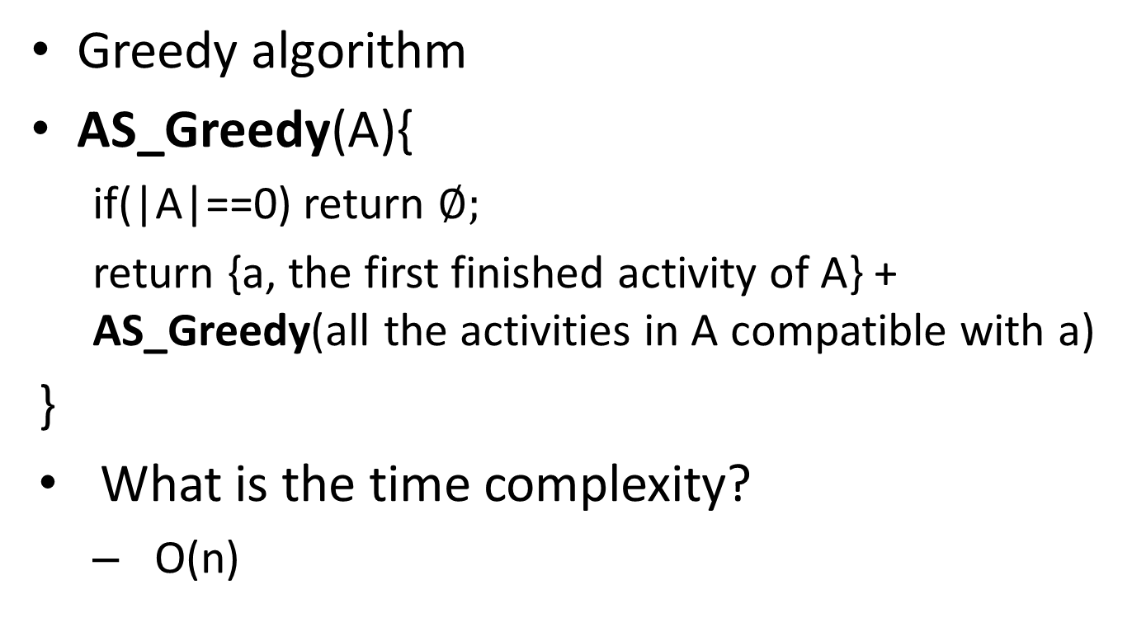
Activity selection
Greedy algorithm
AS_Greedy(A){
if(|A|==0) return $∅;$
return {a, the first finished activity of A} + AS_Greedy(all the activities in A compatible with a)
}
What is the time complexity?
O(n)

Slide 27
Activity selection
An example
a11
a10
a9
a8
a7
What is greedy choice?
a6
What is the sub problem?
a5
a4
a3
a2
a1
0
1
2
3
4
5
6
7
8
9
10
11
12
13
14
15
16

Slide 28
Activity selection
An example
a11
What is greedy choice?
What is the sub problem?
a9
a8
a7
a6
a4
a1
0
1
2
3
4
5
6
7
8
9
10
11
12
13
14
15
16

Slide 29
Activity selection
An example
a11
What is greedy choice?
What is the sub problem?
a9
a8
a4
a1
0
1
2
3
4
5
6
7
8
9
10
11
12
13
14
15
16

Slide 30
Activity selection
An example
a11
What is greedy choice?
What is the sub problem?
a8
a4
a1
0
1
2
3
4
5
6
7
8
9
10
11
12
13
14
15
16

Slide 31

Activity selection
An example
a11
Base case return $∅$
a8
a4
a1
0
1
2
3
4
5
6
7
8
9
10
11
12
13
14
15
16

Slide 32
How to design a greedy algorithm
Find a correct greedy choice

Slide 33
Fractional knapsack and 0-1 knapsack
After you break into a house, how to choose the items you put into your knapsack, to maximize your income.
Each item has a weight and a value
Your knapsack has a maximum weight
0-1 knapsack
You can only take an item of leave it there
Fractional knapsack
You can take part of an item

Slide 34
Fractional knapsack
The fractional knapsack problem is a classic problem that can be solved by greedy algorithms
E.g.
your knapsack can contain 50 lp. Stuff;
the items are as in the figure
What is your algorithm?
30 lb.
20
lb.
10 lb.
$60
$100
$120

Slide 35
Fractional knapsack
A greedy algorithm for fractional knapsack problem
Greedy choice: choose the maximum value/lb. item
10 lb.
30 lb.
50 lb.
20
lb.
20
lb.
10 lb.
$60
$100
$120
$6/lb
$5/lb
$4/lb

Slide 36
0-1 knapsack
The 0-1 knapsack problem is a classic problem that can not be solved by greedy algorithms
Can you design an algorithm of this problem?
As part of next HW
30 lb.
20
lb.
10 lb.
$60
$100
$120

